Slide 1
Performance Testing Overview 2016
Overview of Release Process
June 2016

Slide 2
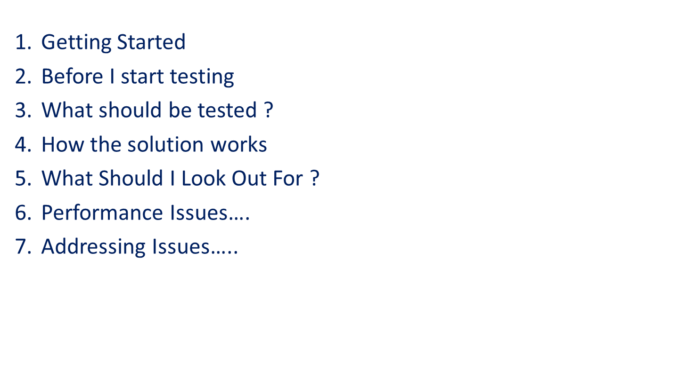

Slide 3
Getting Started
  Standards guide
    link
  Handover Document
    link
  Solution - /Trunk/Code/DELIVERY/business4/Sdm.App/Sdm.Performance/Sdm.Performance.sln
    3 parts to the solution
      Data Prep Tool
      Test Utility
      Test Solution

Slide 4
Before I start testing….
  Liaise with business and looks for the following information :
  Required Capacity of the new functionality ?
    3, 6, 12 month loads.
    Expected usage volumes and growth prediction
  How fast should this action be ?
  How often will this action be used ?
  How critical is this action to the overall scheme area ?
  If there is a long running action, how long does it take and what is the potential of it effecting other areas.

Slide 5
What should be tested ?
  All Finder action .i.e
      Find Clients due for an ARM, Find appointments .
      These tend to take the most time so should always be tested.
  All key user stories should be tested.
    Example : Create means assessment
      Add factor
      Sign off assessment
      Login off
  Any item that the business expects to take a long time.
      Actions that find large amounts of data and actions that can cross over clusters.
  Any action that has a high usage rate.
      This could be a view of a page
      Or a simple actions : Create means assessment.

Slide 6
How the solution works ?
Load Test Utils
This project contains the following useful items :
  Plugins
  Rules
To get the plugin to work on you machine locally please do the following :
  Build the Utils project.
  Copy the DLL to the following locations :
  C:\Program Files\Microsoft Visual Studio 12.0\Common7\IDE\PrivateAssemblies\WebTestPlugins
  C:\Users\XXXXX\Documents\Visual Studio 2013\WebTestPlugins

Slide 7
How the solution works ?
Data Tool
This is a pretty simple winform tool that allows users to :
  Select a database
  Run scripts for given areas into the DB
The main area of the system that needs updating are the two fiels in the xml folder :
  Databases.xml : to add new databases that we can insert data to
  PerformanceTests.xml : The name of the scripts , the scripts are located in the \scripts folder
To ensure the tool remains useful the following must take place :
  All scripts must be re-runnable
  Scripts must contain relevant data prep
  Scripts need to be kept up to date
  There are ways to use the item to create files i.e fileshare.
  Potential to update this to create data via Entity framework in the future.

Slide 8
How the solution works ?
Performance Test
The performance test solution consists of 3 main folders under LOPM
  LoadTests
  StandaloneWebTests
  WebTests
LoadTests: Tests that run a combination of standalone tests
Standalone web tests : Tests that run a specific user interaction, can be tested by itself or included in a load test.
Web Tests : Small pieces of tests, these test individual parts of the system, they are the building blocks of standalone tests

Slide 9
What Should I Look Out For ?
When carrying out Performance tests, it is vital that you monitor what is going on the with the boxes that the application is being run on, Database and App Server .Here you can monitor such stats as :
App Server :
  CPU
  Memory
  ASP.NET Stats
  Process (W3wp)
Database :
  CPU
  Memory
External factors :
  Latency
  Network
  Performance environment is currently shared
Each of the load tests captures all of these stats currently but it is also good to run a perfmon instance while a test is running so you can see the data in real time.
If you have any other queries please add the Performance Test team.

Slide 10
Performance Issues
Current Performance Issues :
  Long running queries getting large amounts of data from the database.
    Should we limit the row count ? DBA would like no more than a couple of hundred coming back
  A number of N+1 issues when getting some data
  Poor queries effect everyone using the system
  Object model can be limiting in some areas.
  Currently there is only one pre prod environment, this is scheduled to be addressed.
New Performance portal will give us an idea of the following :
  Most used actions
  Worst performing actions
  Actions that take a min of 4 seconds
  Combo of average time * occurrences
  This can/will be used to look at areas that need improvement.

Slide 11
Addressing Issues
What needs to be done.
  Define processes for addressing issues
  Define process for how a issue should be fixed
    Object Modelling Team need to be involved.
  Define how much data should be the maximum coming from the database from finder actions
      DBA to set out guidelines here…
      These standards need to be communicated to project teams and monitored prior to the initial release.
  We need more than one performance environment
  We need to schedule capacity for performance improvements
  We need ownership of performance improvements
    Monthly catch-up after monthly go live to go through results ??

Slide 12
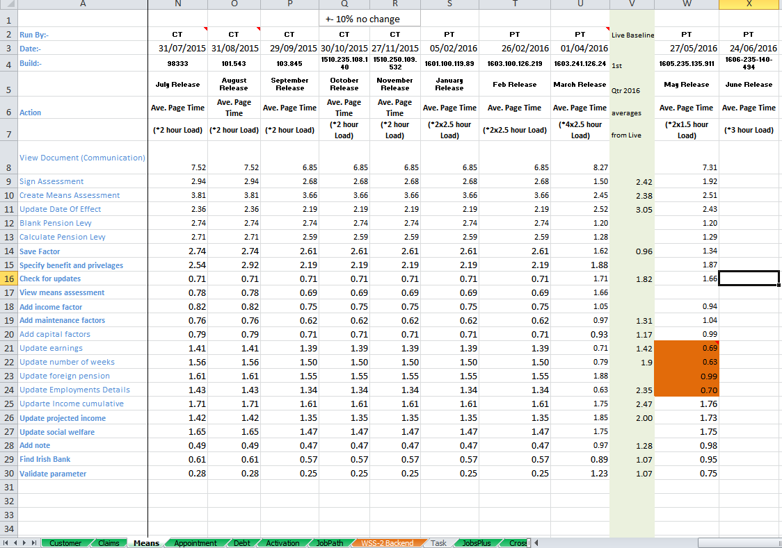
We record all Metrics for the Performance Tests runs

Slide 13
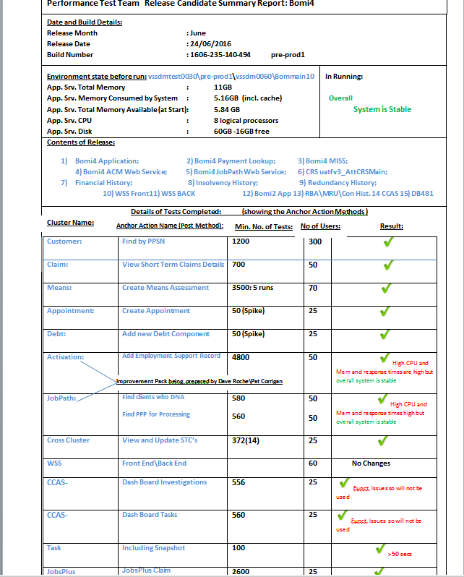
S
U
M
M
A
R
Y
R
E
P
O
R
T
I
S
I
S
S
U
E
D

Slide 14
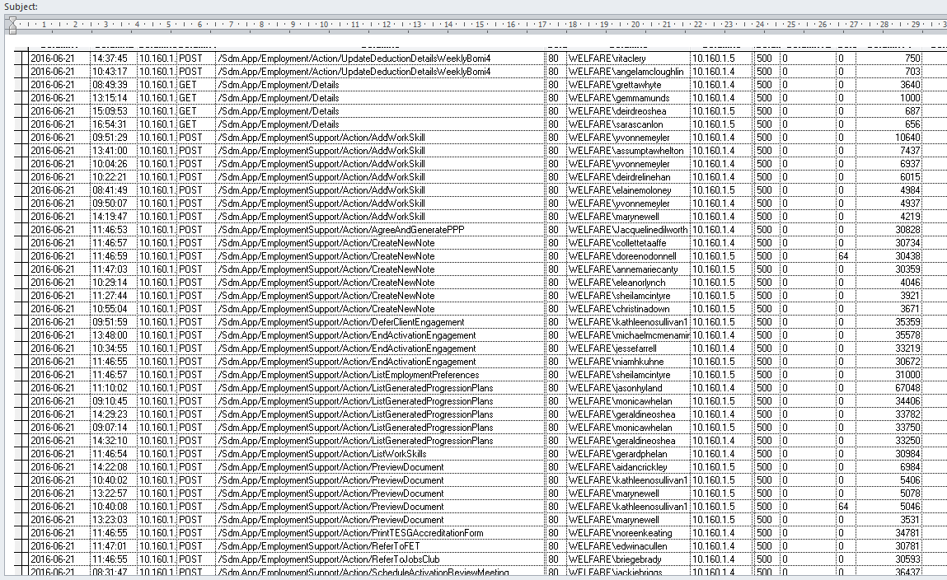
Further Detailed Analyses

Slide 15
The importance of Performance Testing and analyses
Some Stats:
Number of HTTP status code ‘ 500’ errors in Live for 1 day (21/06/2016) = 1126
( out of 1.6 million transactions on the day)
Server Time involved: =11437 seconds
= 190 Minutes
= 3 Hours and 10 Minutes of server time.
On the same day, the Number of Bomi4 requests greater than 10 Seconds
= 15902
= 159020 seconds (just take X10 for simplicity)
=44 Hours of server time
The Cost= Financial/Reputational/Client/Legal ?????

Slide 16

Any Questions ?

Slide 17
Demo ????
Creating and Running a Test Demo
Areas covered in this demo
  Creating a new test
  Recording a new test
  Adding parameters
  Adding a data source
  Using the data tool
  Running the data tool
  Creating a stand alone test
  Running a stand alone test
  Creating a load test
  Running a load test

